Slide 1
Get Picked!
How to write a presentation description.

Slide 2
Why Bother?
“fancy quote or something”

Slide 3
Why Bother?
Free Conference Admission
Challenge
Learning Opportunity
Personal Exposure
Rush/Fun
Partnering
Improving Marketing

Slide 4
5 Steps
Find Your Soapbox
Craft Your Blurb
Awesomize Your Title
Brand Yourself
Show It Off
Get Accepted
Build Your Presentation
And then…

Slide 5

Find Your Soapbox
Step 1

Slide 6
Topic
Do you have something to say?
Do | Don’t
Go with your passion | Go with what’s popular
Find a unique twist | Report on existing works
Keep it simple | Lose them
Keep it focused | Boil the ocean

Slide 7
Exercise
In your teams, discuss:
What do you talk about with your clients? With other Improvers? With people who share your passions?
What’s the thing that you know that others would benefit from knowing?
What have you shared in the past that made someone say, “Oh, I never thought of it like that before”?
Help each other write a draft title that captures the essence of your topic.

Slide 8

Craft Your Blurb
Step 2

Slide 9
Anatomy of an Abstract
Should have a… | Should be…
Hook | Small
Problem to solve | Simple
Takeaway | Well Written
Invitation

Slide 10
Anatomy of an Abstract
Get Picked: how to write a presentation abstract that will pack the room
Hook
Conference reviewers and attendees scan presentation descriptions in seconds. The title needs to grab their attention immediately and the abstract must promise something they need.
The first session will introduce 5 steps for creating a winning abstract, title, and even speaker bio.
In the second hands-on session, you will apply these steps for your next talk -- which will certainly be jammed packed the next time you deliver it.
Problem
Takeaway
Invitation

Slide 11


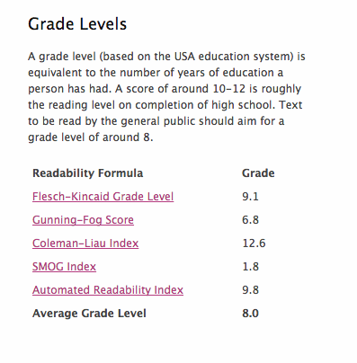
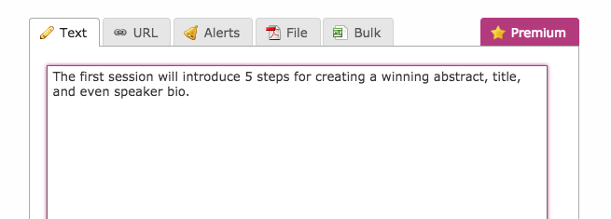
Small, Simple, & Well Written

Slide 12
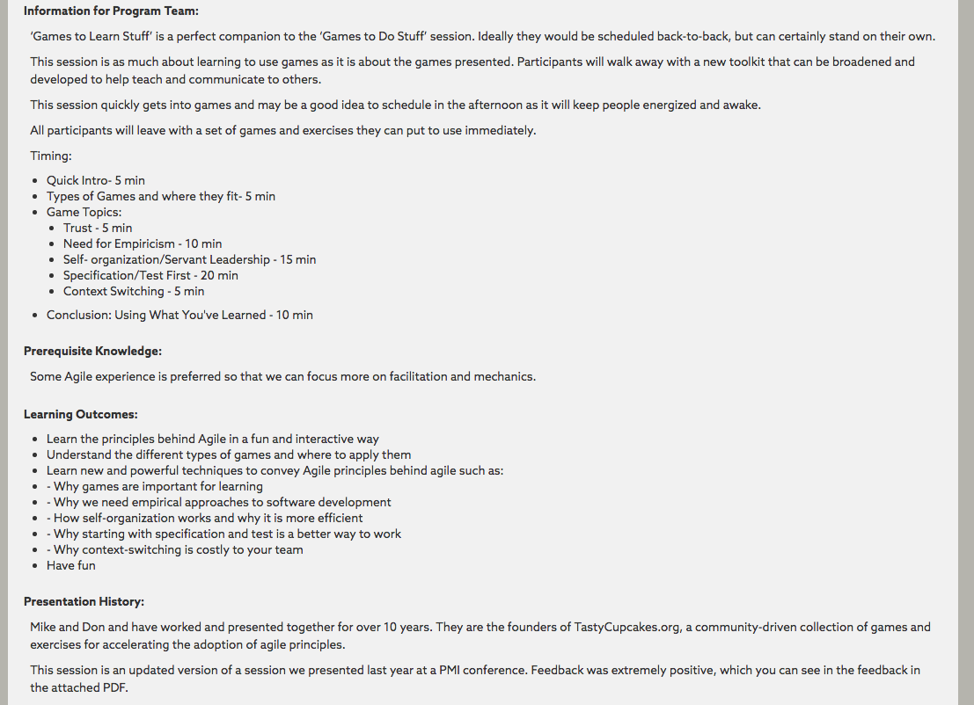
For Organizers…
Maybe a little extra work…
Logistics
Timing
Prerequisites
Learning Objectives
Presentation History

Slide 13

Awesomize Your Title
Step 3

Slide 14

Titles
Attention Getting.
Not Precise.
Think
Book Title
Optional Subtitle

Slide 15

Brand Yourself
Step 4

Slide 16
Bios – Dos/Donts
Do | Don’t
Mention Improving ☺ | Emphasize your job title
Describe what makes you unique | Write in first person
Keep it short and well-written | Focus on only your past activities/jobs
Establish credibility by highlighting your experience | Include a long list of certifications or degrees

Slide 17
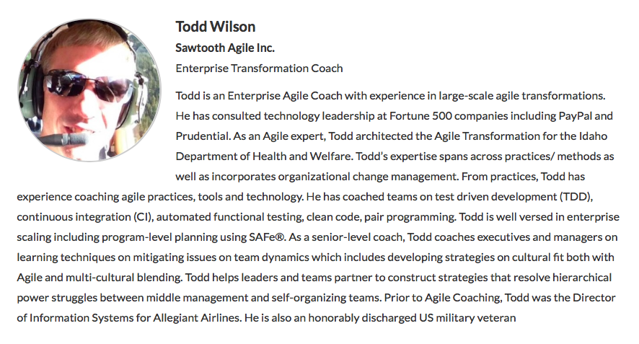
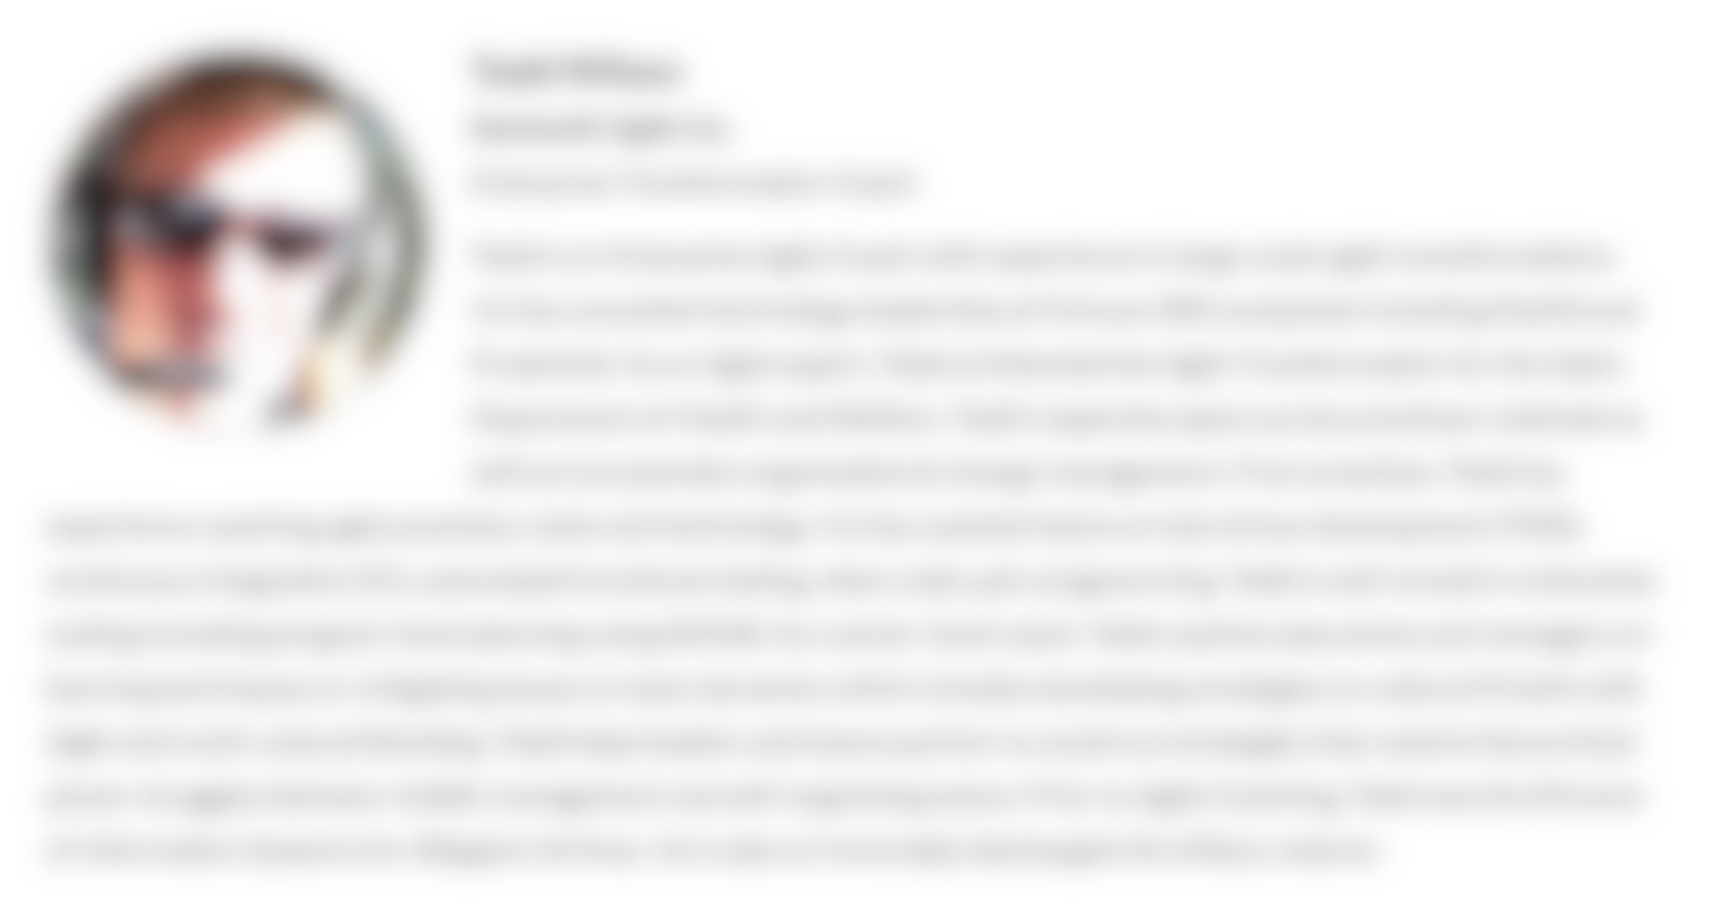
Not-so-great bio to help refine previous slide

Slide 18

Show It Off
Step 5

Slide 19
Inspect & Adapt
Friends
Family
Colleagues
The Internets

Slide 20
Only then do you…
And after all that,

Slide 21
Submit
User Groups
Lunch-n-Learns
Conferences
AgileDotNext

Slide 22


Build It
Nothing like having a scheduled talk for motivation.

